Slide 1

Titan Incident Case Study
Team Swords

Slide 2
Presentation Overview
Part 1: The Titan Incident
- Timeline and overview of events, applying TFO model, applying ISACA methodology model
Part 2: Should Titan be brought back online?
- Applying ISO standards
Part 3: What can be done to improve the system?
- Applying the PDCA cycle
Part 4: Conclusion
- Looking at where Titan is today
- The Olympic comparison

Slide 3
Should Titan be brought back online immediately?
NO!

Slide 4
Part 1:
1
The Titan Incident

Slide 5
The Incident
Margrete Raaum, Computing Emergency Response Team (CERT) manager at the University of Oslo (UiO), learned about a network attack on Titan, a high-performance computing cluster (HPCC) on August 9, 2011
Titan supported research conducted by scientists at CERT and other research institutions across Europe
At Raaum's direction, Titan's master and login nodes were taken offline on the same day
By 20:00 on 12, August 2011, a decision needed to be made: Was it okay to bring Titan back online?

Slide 6
Timeline of Events
Oct. 10 2010
Notification of a vulnerability (GNU glibc $ORIGIN Substitution Privilege Escalation) was released by a researcher
Nov. 10 2010
UiO Operation’s team is notified that the glibc vulnerability has been used to compromise grids at other facilities
June 23 2011
An attacker accesses one of Titan’s login nodes, using credentials that are later revealed to have been stolen from a Spanish university
June 24 2011
A second login node is compromised
July 15 2011
Master node is compromised
Aug. 9 2011
17:01 - Raaum is notified of attack
17:30 – Master node and login nodes taken offline
17:45 - UniNETT is notified of the outage
18.34 - Grid partners are notified of the outage

Slide 7
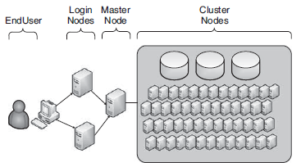
About Titan
2 login nodes and 1 master node
Provided access to more than 5000 core processors capable of performing 40 trillion floating point operations per second
All systems in the Titan cluster ran on a Linux-based operating system called CentOS

Slide 8

About Titan
What Titan was used for:
Part of several research collaborations such as the Nordic Data Grid Facility (NDGF), which was created to serve as a regional computing center to process data generated by the Large Hadron Collider at the European Organization for Nuclear Research
Also supported several multi-university astrophysics research projects
Was essential to molecular biology research, DNA sequencing analysis, and petroleum reservoir simulations
Many scientists took advantage of Titan’s extensive computational power by writing their own custom applications for their research

Slide 9
About Titan
Some issues with Titan:​
No standards governed the software levels running on the nodes​
Some organizations that partnered with UiO did not have sufficient resources to test software patches in their lab before patch deployment​
Because network operations teams were concerned that untested patches could have negative impacts, patches were generally only installed when deemed absolutely necessary

Slide 10
Applying the TFO Model
Threats​
Database and password synchronized​
Cluster with different patch level may not be regulated​
Team collaboration issue​
Master and login nodes have access to all of the other computers in the cluster​
Features​
A virtual team of ten individuals who worked on security issues for Titan on a part-time, as-needed basis​
UiO network operations team responsible for updating and patching systems running on Titan​
Objects​
Username and password​
Scientific data​

Slide 11
ISACA Incident Response Model
1. Planning and preparation
2. Detection and investigate
3. Containment and analysis
4. Tracking and Recovery
5. Post-incident assessment
6. Incident closure

Slide 12
1. Planning and Preparation
UiO CERT team structure:
Virtual team of 10 individuals, part-time, as-needed functions
Internal centralized CSIRT
Advantages:
Dedicated service for parent organization
Hands-on support
Leverage for quantity discounts on related products
Direct feedback loop for improving overall security
Diverse knowledge base
Disadvantages:
Promotes social loafing (members can hide among the group)
Process losses – increased workload, irregular familiarity
Challenges in communication, coordination, developing trust relationships
Time delays in completing tasks
Mitropoulos, S., Patsos, D., & Douligeris, C. (2006). One Incident Handling and Response: A state-of-the-art approach. Computers& Security, 25(5), 351-37

Slide 13
2. Detect and Investigate
Detect
Engineer in UiO's research computing operations group detected break-in on Titan cluster and informed Raaum
Investigation - Raaum gets outside help for the investigation
Raaum received an email from Lief Nixon, a security officer at the National Supercomputer Center at Linköping University in Sweden (which was also part of NDGF) asking what happened
Nixon reached out with an offer to help analyze any evidence her team had collected. He offered to perform binary analysis in his sandbox, to provide details on how code or tools installed by the attacker functioned
This was a resource that Raaum did not have readily available, so she eagerly accepted his offer

Slide 14

2. Detect and Investigate
Investigation – What happened prior to discovery of the breach
UiO operations team sent email about glibc variable substitution vulnerability in November 2010 to Raaum
Operations team noticed suspicious behavior weeks before notifying Raaum
Operations team excuse for this was that they thought a researcher must have been conducting an experiment

Slide 15
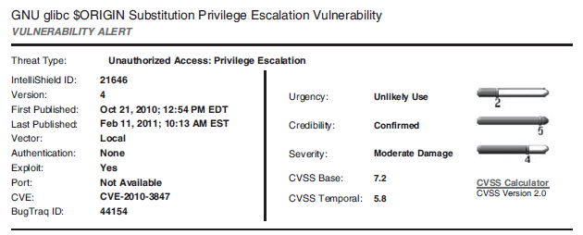
glibc Variable Substitution Vulnerability

Slide 16
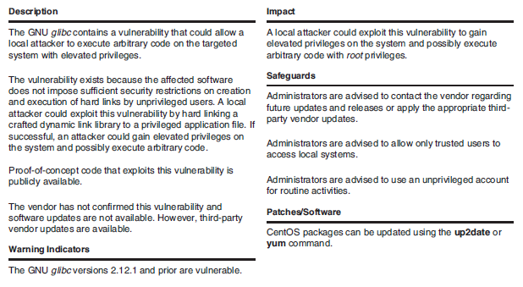

Slide 17
2. Detect and Investigate
Investigation – How the attacker gained access
Information obtained by looking at local system logs
On June 23, 2010, one login node was accessed by attacker. Within 10 minutes of accessing the system, the attacker had used the compiler on Titan to exploit the glibc variable substitution vulnerability
Attacker then gained administrative access to the mode and downloaded software libraries to the system
These libraries enable the attacker to compile a modified version of the secure shell (SSH) program, which was the main way users accessed the Titan cluster
The modified SSH could record the usernames, passwords, and SSH access keys of accounts as users accessed the cluster
Now the attacker could use the stolen credentials to access other systems

Slide 18

2. Detect and Investigate
Investigation – How the attacker gained access
The attacker also inserted a backdoor, ensuring that the attacker could regain access to the Titan nodes even if all passwords were reset
The second login node and the master node were later compromised in a similar manner

Slide 19
2. Detect and Investigate
Investigation – Identifying the source of the attack​
Audit logs indicated which user accounts were using Titan on June 23 (day of initial attack)​
5 researchers that were part of a astrophysics research collaboration were using Titan at that time​
The attacker used the account of 1 of these researchers to gain access to the system​

Slide 20
2. Detect and Investigate
Investigation - Identifying critical resources and information that were compromised​
Information from all computers in the cluster, along with 271 terabytes of shared disk space, supporting research in natural sciences and engineering at the university along with research from other universities and institutions​
Usernames and passwords for researchers working at the institutions​
Concerns:​
UiO did not experience revenue loss but experienced a reputational cost every day the Titan cluster was down. Researchers were not able to process or access their data and the university was not able to fulfill their obligations to the NDGF and other partners.

Slide 21

3. Containment and Analysis
Titan's login and master nodes were taken offline to contain the incident

Slide 22
Part 2:
2
Should Titan be brought back online?

Slide 23
Should Titan be brought back online immediately?
NO!

Slide 24



Why Titan is NOT READY to be Online
Know What You Have
Most sensitive data needs to be identified and given maximum protection
Communicate with Stakeholders
This makes for a dynamic user base chat requires diligent execution of a well-defined protocol for promptly granting and revoking access
Incident Response Plan Not in Place
The Incident response plan is like a fire safety plan;it needs to be developed by someone with experience of working with the institution.
Coffman, D. (2014). Managing data protection in higher education. Risk Management, 61(7), 32-35

Slide 25


Why Titan is NOT READY to be Online
Analysis Of The Attack
Conduct in-depth analysis of the end-to-end workflow of the attack
They only have a virtual part-time team and network operation team(Not info security team)
Dedicated Information Security Team
Coffman, D. (2014). Managing data protection in higher education. Risk Management, 61(7), 32-35

Slide 26
Major Stakeholders
University students and faculty utilizing Titan for research and study (Primarily in the Nordic Countries: Denmark, Finland, Iceland, Norway, Sweden)
At risk: Sensitive timing of research and paper submission
Institutions/people providing grants for research
At risk: Continuation of funding and/or fund size
The Nordic High Energy Physics community (the ALICE, ATLAS and CMS Virtual Organizations)
At risk: Loss of connection to national research and educational network, UniNETT
University of Oslo
At risk: Damage to reputation, recruitment of students and faculty
UiO CERT, CERT manager, Senior UiO management, UiO network operations team, UniNet Security team
At risk: Their jobs

Slide 27
COLLABORATION
The word that may skip a heart-beat or two :)

Slide 28
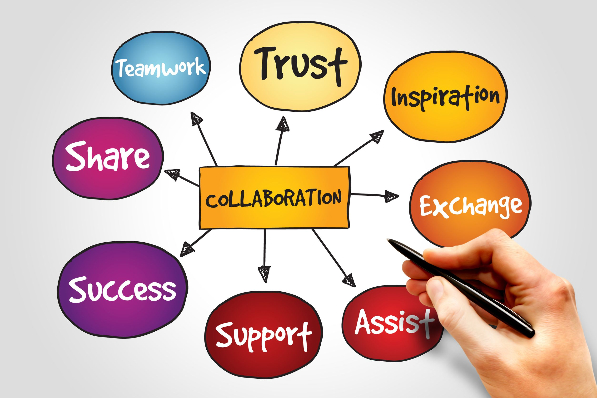
Why Collaboration?
Security is a ‘wicked’ problem, meaning it cannot be divided into neat parts and crosses the roles and responsibilities of many different actors
Collaboration is not cooperating to achieve individual goals or coordinating to achieve broader goals, but ‘working together’ to achieve ‘shared’ goals.
Collaboration is constantly changing, meaning it ‘is best examined as a dynamic or emergent process rather than a static condition’
Collaboration involves a greater intensity in terms of both the level of interaction between network members as well as the strength of ties.
For Titan, different groups like groups from each of the universities sharing Titan for their use, one from the CERT team, one from public relations, one from the legal team and one from the department that measures the incurred liability
Whelan, C. (2017). Managing dynamic security networks: Towards the strategic managing of cooperation, coordination and collaboration. Security Journal, 30(1), 310-327

Slide 29
6 Critical Keys for Effective Collaboration for Virtual Teams
Trust – Lack of interpersonal interactions challenges the establishment of trust between members, trust must be founded through other means (off site team building activities)
Cultural and language differences - Cultural norms could be misunderstood, and language differences are magnified in limited communication streams.
Communication – Tools & rules of engagement, use of shared electronic work spaces
Social skills – Major prerequisite for good communication and relationship building
Mission and goal clarity – Common understanding to team’s deliverables
Rewards and recognition – Project and personal performance incentives need to align with diversity of the team
Van Wyk, K., Forno, R. (2001). Incident response. New York: O’Reilly.
Mitropoulos, S., Patsos, D., & Douligeris, C. (2006). One Incident Handling and Response: A state-of-the-art approach. Computers& Security, 25(5), 351-37
Watanuki, H. M., & Moraes, R. d. O. (2016). Does size matter? an investigation into the role of virtual team size in IT service provisioning. Industrial Management & Data Systems, 116(9), 1967-1986.
Brahm, T. and Kunze, F. (2012), “The role of trust climate in virtual teams”, Journal of Managerial Psychology, Vol. 27, pp. 595-614.

Slide 30
ISO 27000 Standards on the Ideal Response to a Network Attack
The ISO 27000 family of standards helps organizations keep information assets secure
Mobilize Incident Response Team – Part of ISO 27035-2: Guidelines to plan and prepare for incident response
Ensure Business Continuity- Part of ISO 27002 - Section 17: Information security aspects of business continuity management
Conduct Investigation – Part of ISO 27035-1: Principles of incident management
Manage Public Relations - ISO/IEC 27035-2: Guidelines to plan and prepare for incident response
Address Legal Requirements – Part of ISO27035-2: Guidelines to plan and prepare for incident response
Incur Liability - ISO/IEC 27035-2: Guidelines to plan and prepare for incident response
Red = The requirement has not been met
International Organization for Standardization. Retrieved from https://www.iso.org/home.html

Slide 31
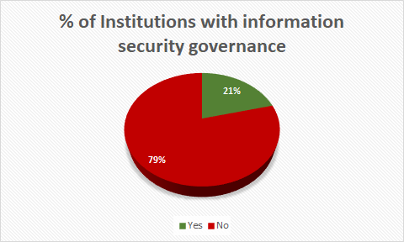
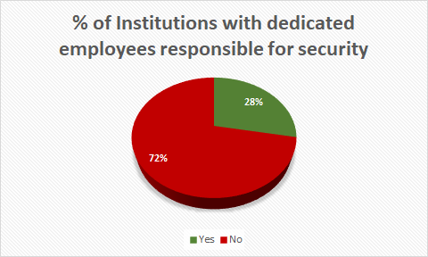
Statistics about Educational Institutions
Jones, E. (2017, Sep 5). 77% of educational institutions are not prepared for IT risks, says Netwrix survey. Retrieved from https://www.prnewswire.com/news-releases/77-of-educational-institutions-are-not-prepared-for-it-risks-says-netwrix-survey-300514007.html

Slide 32
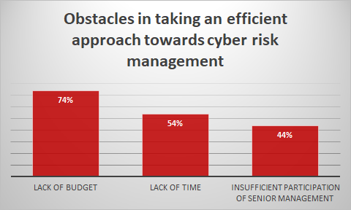
Statistics about Educational Institutions
Jones, E. (2017, Sep 5). 77% of educational institutions are not prepared for IT risks, says Netwrix survey. Retrieved from https://www.prnewswire.com/news-releases/77-of-educational-institutions-are-not-prepared-for-it-risks-says-netwrix-survey-300514007.html

Slide 33
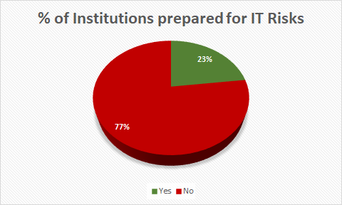
Statistics about Educational Institutions
Jones, E. (2017, Sep 5). 77% of educational institutions are not prepared for IT risks, says Netwrix survey. Retrieved from https://www.prnewswire.com/news-releases/77-of-educational-institutions-are-not-prepared-for-it-risks-says-netwrix-survey-300514007.html

Slide 34
Part 3:
3
What can be done to improve the system so it is better prepared for future incidents?

Slide 35
How to ensure system is better prepared for a future incident
Apply PDCA Cycle!

Slide 36
PDCA Cycle
Plan
Works out the solution and improvement plan according to the major factors
Do
Check
Identifies the major factors from various causes
Finds out various causes resulting in those problems
Analyses the current conditions and finds out the existent problems
Act
Carries out the plan and measures
Checks the implements according to requirements of the plan
Turns problems that haven't been solved or appear newly into the next cycle
Summarizes experiences and consolidates achievements
Ren, M. M., Ling, N., Wei, X., & Fan, S. H. (2015, 20-22 Nov. 2015). The Application of PDCA Cycle Management in Project Management. Paper presented at the 2015 International Conference on Computer Science and Applications (CSA).

Slide 37
Plan
Determine internal & external issues:
The threats mentioned in previous slides
Determine interested parties:
Universities and research institutes
Define scope of information security management:
User credentials and scientific data
Policies:
The university should have security protocol to follow with
Leadership, roles and responsibilities:
CERT Manager reports to Principle, info security specialist reports to CERT manager
Determine competence required:
Build a professional, full-time info security team
Formulate risk treatment plans:
Mentioned in ISO slide

Slide 38
Plan - Finding Existing Problems in Internal CSIRT by Applying 4I to UiO ​
Focus of the 4I Organizational Learning Framework:​
Process Improvement – continual proactive approach to achievement of optimal efficiency​
Double-loop learning principles – further than simple corrective action to questioning flaws in current process and procedures​
Structured learning approach across individual, group, and organization levels​
Ahmad, A., Maynard, S. B., & Shanks, G. (2015). A case analysis of information systems and security incident responses. International Journal of Information Management, 35, (2015) 717-723.

Slide 39
Plan - Finding Existing Problems in Internal CSIRT by Applying 4I to UiO
4I Organizational Learning Framework ​
Intuiting and attending – develop individual capability to discern new patterns of activity without conscious effort​
Lacking - Raaum did not apply discernment when first presented in November 2010 with possible vulnerability. Improve by applying an inquisitive attitude.​
Interpreting and experimenting – social activities designed to allow individual insight to be shared and enacted within a group​
Lacking - CERT team and UiO network operations team worked independently without common goals or communication channels. Collaboration!!​
Integrating – allows group collective and coordinated action to ensue​
Improved - Raaum accepted assistance from Nixon for evidence analysis​
Institutionalizing – formalized structures, systems and procedures to retain individual and group learning​
Lacking - no mention in case of structure, systems or procedures. See other suggestions to apply formal documented processes.
Ahmad, A., Maynard, S. B., & Shanks, G. (2015). A case analysis of information systems and security incident responses. International Journal of Information Management, 35, (2015) 717-723.

Slide 40
Plan - Ways to Improve Titan's Infrastructure: Automation
The University of Luxembourg (UL) has operated successfully on a HPC facility and the related storage by a small team since 2007. Some researchers at UL put together a paper regarding best practices in cluster architecture and management for academic HPCs​
UL uses an automation software called Puppet, which helps system administrators to manage their infrastructure throughout its life cycle, from provisioning and configuration to patch management and compliance​
A similar automation software could be implemented with Titan. This would make it easy to automate repetitive tasks, quickly deploy critical applications, and pro-actively manage change in a scalable way ​
This could help solve the issue of updating/patching the system manually
Varrette, S., Bouvry, P., Cartiaux, H., & Georgatos, F. (2014, 21-25 July 2014). Management of an academic HPC cluster: The UL experience. Paper presented at the 2014 International Conference on High Performance Computing & Simulation (HPCS).

Slide 41
Plan - Ways to Improve Titan's Infrastructure: Fault Tolerance Solutions
To reduce the mean time to repair systems and maintain high availability for Titan, Fault Tolerance (FT) solutions can be used​
For example, a fault tolerance manager for coordinated checkpoint files can be implemented, which would provide users automatic recovery from failures when losing computing nodes​
Fault Tolerance is critical for the sustained growth of a HPC cluster such as Titan
Villamayor, J., Rexachs, D., & Luque, E. (2017, 17-21 July 2017). A Fault Tolerance Manager with Distributed Coordinated Checkpoints for Automatic Recovery. Paper presented at the 2017 International Conference on High Performance Computing & Simulation (HPCS).

Slide 42
Do
Be communicative and updated​
More communication between CERT and NDGF ​
Implementation and awareness of policies​
University should develop, deploy security framework, and periodically refresh some level of security awareness and training​
Encryption model to be added at every node​
Review Consequences of changes made​
Periodic check to look for vulnerabilities as side effects​
Push Latest Patches​
Patches should be installed earlier rather than waiting if it was necessary​
Backup​
​

Slide 43
Check
Information security risk assessment​
Establish and maintain info to see risk criteria:
Implement risk assessment report on daily/weekly basis​
Ensure risk assessment produces consistent, valid and comparable result​
Team supervisor evaluates the report​
Identify and Analyze risks​
The team should identify and analyze risks if there is any ​
Evaluate/Prioritize risk for treatment​
CERT manager evaluates and prioritize risk for treatment ​
Audit​
Third party should get involved in auditing the assessment​

Slide 44
Act
Select appropriate treatment options ​
Corrective measures should be taken with proactiveness
Determine controls necessary to implement the risk treatment​
Risk Centered Practices should be included​
Keep check on controls implemented​
Immediate action on the email regarding breach​
Continuous check for preventive measures to be taken​
Obtain risk owner approval​
Hierarchy to be present in the team to take up ownership and responsibility

Slide 45
Part 4:
4
Conclusion

Slide 46

Current Situation
On Sep. 25, 2012 12:41 PM, UiO published a page on their website called "Changes since Titan"
UiO set up a new cluster called Abel to replace Titan. This page documents the differences between the two clusters
There are differences in the following areas:
Queue system / job scripts
Storage / file systems
Hardware
Software
Changes since Titan. Retrieved from https://www.uio.no/english/services /it/research/hpc/abel/help/faq/changes-since-titan.html

Slide 47

The Olympic Analogy
KEY ATTRIBUTES OF SUCCESSFUL OLYMPIC ATHLETES
Have a game plan and perfect your craft
Work with best coach and teachers
Teamwork is the key
Poise under pressure
LEARNINGS FOR SECURITY INCIDENT RESPONSE TEAM
A well-documented strategy
Identify core response team and an outside expert : “Breach Coach” supporting internal incident response
Communication for regularly sharing updates on the incident
Stay calm and remain agile to adjust according to incident
Bruemmer, M. (2016, Sep 2). Data breach digest: Going for the gold in data breach incident response. Retrieved from http://www.securityinfowatch.com/article/12252878/data-breach-digest-going-for-the-gold-in-data-breach-incident-response

Slide 48
Bibliography
Brahm, T. and Kunze, F. (2012), “The role of trust climate in virtual teams”, Journal of Managerial Psychology, Vol. 27, pp. 595-614.
Brandt, Virginia, et al. "Virtual Teams." Research Technology Management, vol. 54, no. 6, Nov/Dec2011, pp. 62-63.
Bruemmer, M. (2016, Sep 2). Data breach digest: Going for the gold in data breach incident response. Retrieved from http://www.securityinfowatch.com/article/12252878/data-breach-digest-going-for-the-gold-in-data-breach-incident-response
Changes since Titan. Retrieved from https://www.uio.no/english/services /it/research/hpc/abel/help/faq/changes-since-titan.html
Coffman, D. (2014). Managing data protection in higher education. Risk Management, 61(7), 32-35
International Organization for Standardization. Retrieved from https://www.iso.org/home.html
ISACA (2012). Cybercrime Incident Response and Digital Forensics
Jones, E. (2017, Sep 5). 77% of educational institutions are not prepared for IT risks, says Netwrix survey. Retrieved from https://www.prnewswire.com/news-releases/77-of-educational-institutions-are-not-prepared-for-it-risks-says-netwrix-survey-300514007.html

Slide 49
Bibliography
Mitropoulos, S., Patsos, D., & Douligeris, C. (2006). One Incident Handling and Response: A state-of-the-art approach. Computers& Security, 25(5), 351-37
Van Wyk, K., Forno, R. (2001). Incident response. New York: O’Reilly.
Varrette, S., Bouvry, P., Cartiaux, H., & Georgatos, F. (2014, 21-25 July 2014). Management of an academic HPC cluster: The UL experience. Paper presented at the 2014 International Conference on High Performance Computing & Simulation (HPCS).
Villamayor, J., Rexachs, D., & Luque, E. (2017, 17-21 July 2017). A Fault Tolerance Manager with Distributed Coordinated Checkpoints for Automatic Recovery. Paper presented at the 2017 International Conference on High Performance Computing & Simulation (HPCS).
Watanuki, H. M., & Moraes, R. d. O. (2016). Does size matter? an investigation into the role of virtual team size in IT service provisioning. Industrial Management & Data Systems, 116(9), 1967-1986.
Whelan, C. (2017). Managing dynamic security networks: Towards the strategic managing of cooperation, coordination and collaboration. Security Journal, 30(1), 310-327

